Slide 1
Tutorials
31.3.25

Slide 2
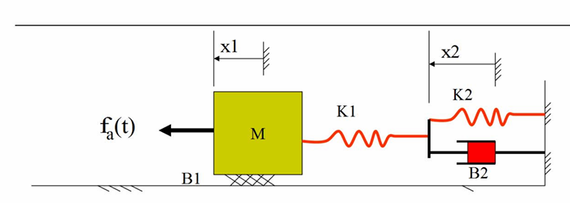
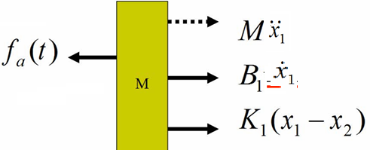

No. of STATES….?

Slide 3





Let
OUTPUT EQUATION:

Slide 4

Arranging in the standard form ( i.e. in the MATRIX FORM) such as the STATE MODEL is ….

Slide 5
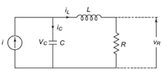
Obtain the state model of the system

Slide 6
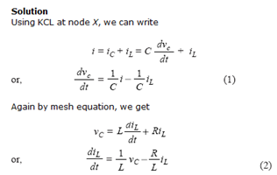

Slide 7


For state model :
Output is
Consider suitable state variable and write the state model.

